Slide 1
Measuring Planck’s Constant by Observation of the Photoelectric Effect

Slide 2
Theory
Photoelectric Effect: Electrons can be ejected from a metal irradiated by electromagnetic radiation.
The kinetic energy of the ejected electrons was found to increase with the frequency of the radiation, not the intensity.
Albert Einstein explained this by hypothesizing that light does not travel as a wave but rather as particles.

Slide 3
Theory
Einstein hypothesized that the photons carried energy proportional to the frequency of the light, with Planck’s constant as the proportionality constant.
Increased intensity: more photons, but not more energy in each photon

Slide 4
Experiment
Irradiate a metal cathode, pick up ejected electrons on an anode and measure the produced current.
Vary the voltage between cathode and anode to find the stopping voltage.
Measure stopping voltage for several wavelengths of light.
Then by energy conservation, we have:
|V_{s}| = (hc/e) (1/λ) + Φ/e

Slide 5
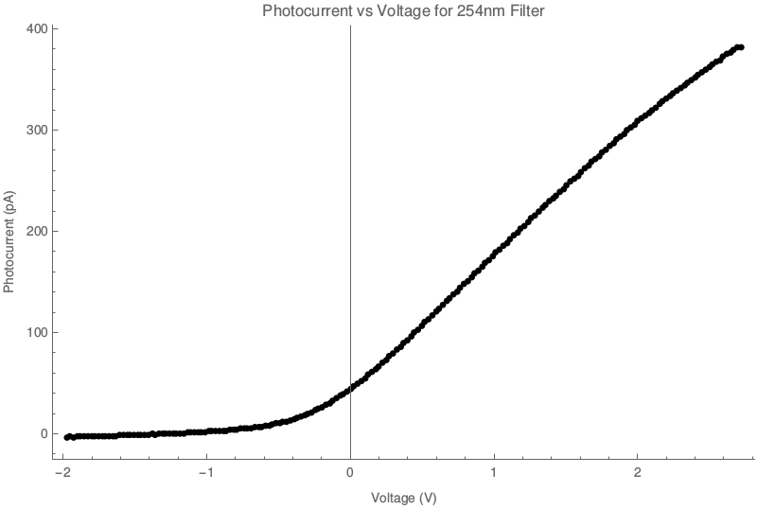
Current Vs. Voltage Graph

Slide 6
Determination of Stopping Potential
Used a statistical technique.
Fit a line to the first thirty data points.
Calculated the standard deviation of these points from the fitted line.
Found a critical line, which was the best fit line shifted up three standard deviations.
Defined the stopping potential to be the voltage that corresponded to the first data point for which all subsequent points lie above the critical line.

Slide 7
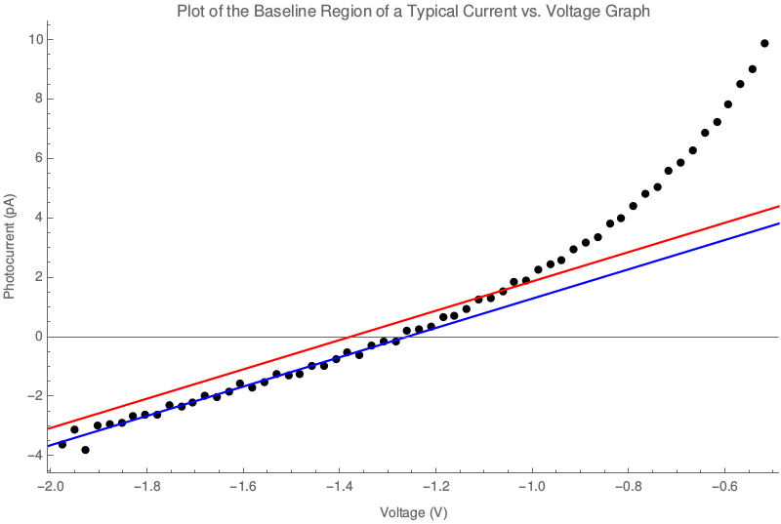

Slide 8
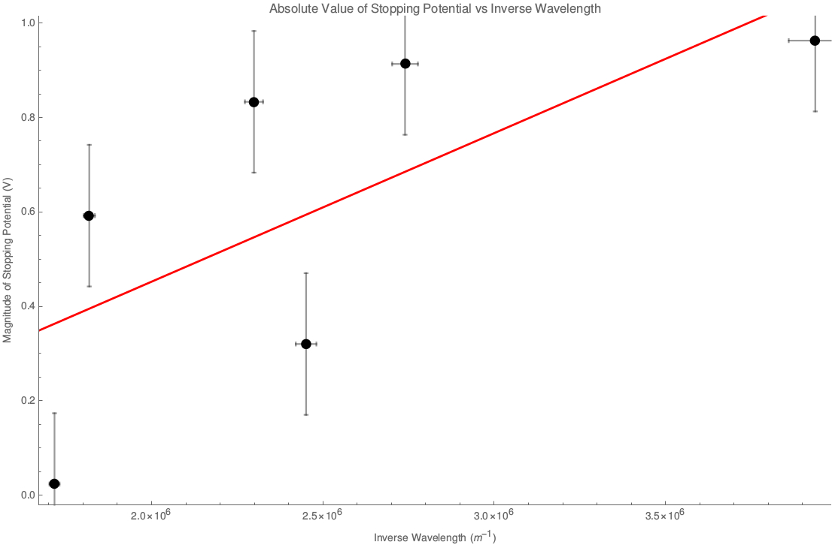
Results

Slide 9
Results
Best fit line: |V_{s}| = (3.1 × 10⁻⁷ ± 0.8 × 10⁻⁷ Vm) (1/λ) + (−0.2 ± 0.2 V)
This implies values of:
h = 1.6 × 10⁻³⁴ ± 0.4 × 10⁻³⁴ Js
Φ = −0.2 ± 0.2 eV
These results do not agree with the accepted values of these quantities.

Slide 10
Errors in Results
Noise in the current measurements.
Filters having an unknown effect on the incident light.

